Slide 1
Token-based dictionary pattern matching for text analytics
Authors: Raphael Polig, Kubilay Atasu, and Christoph Hagleitner
Publisher: FPL, 2013
Presenter: Chia-Yi, Chu
Date: 2013/10/30

Slide 2
Outline
Introduction
Dictionary Matching and Text analytics
Architecture
Implementation
Evaluation

Slide 3
Introduction (1/3)
A novel architecture consisting of a deterministic finite-state automaton (DFA) to detect single token-based patterns and a non-deterministic finite-state automaton (NFA) to find token sequences or multitoken patterns.
  DFA: “High-performance pattern-matching for intrusion detection,” INFOCOM 2006.
  NFA: “Fast regular expression matching using fpgas,” FCCM 2001.
Implemented on an Altera Stratix IV GX530, and were able to process up to 16 documents in parallel at a peak throughput rate of 9.7 Gb/s.

Slide 4
Introduction (2/3)
Text Analytics (TA)
  Extracting structured information from large amounts of unstructured data
Dictionary Matching (DM)
  the detection of particular sets of words and patterns
  Before DM is performed, a document is split into parts called tokens.
  By splitting the text at
    whitespaces and/or
    other special characters or
    more complex patterns

Slide 5
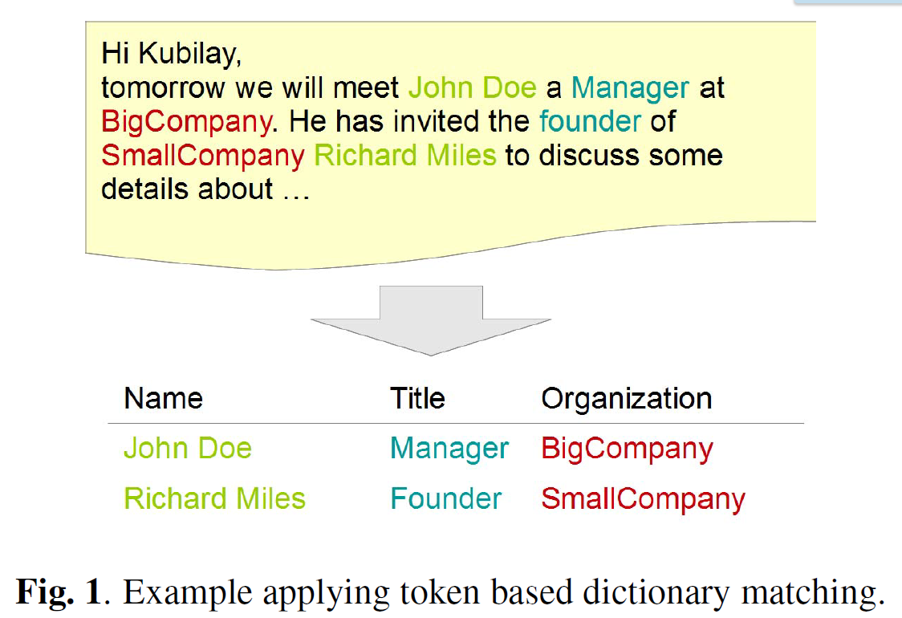
Introduction (3/3)

Slide 6
Dictionary Matching and Text analytics (1/2)
Text analytics adds specific details to pattern matching
  Tokenization
The text data gets split into parts, so-called tokens
The output of the tokenizer is a set of tuples, each consisting of a start and end offset of a token within the text data.
Matches found by the pattern matching algorithm are only valid if the start and end offsets of the found pattern match the offsets for the given token.
  similar to the regular expression \bJohn\b where John is only valid at word boundaries.

Slide 7
Dictionary Matching and Text analytics (2/2)
Patterns consisting of a sequence of tokens are referred to as multi-token patterns.
  e.g., Assuming John and Doe are defined as tokens, it does not matter by what characters they are separated as long as these two tokens appear in sequence.
Text analytics allows the use of simple regular expressions in dictionaries
  e.g., a dictionary may contain various date formats
Requires exact operation
  Exclude the approaches causing false positive results

Slide 8
Architecture (1/12)
High-level view of the architecture
  Single token Matching
    A DFA-based architecture is used to provide a deterministic scan rate of the document text data.
  Multi token Matching
    An NFA based circuitry is used which advances its states on a token by token basis.
  All its detected patterns are reported as a combination of
    the start offset
    the end offset
    the dictionary identifier value

Slide 9
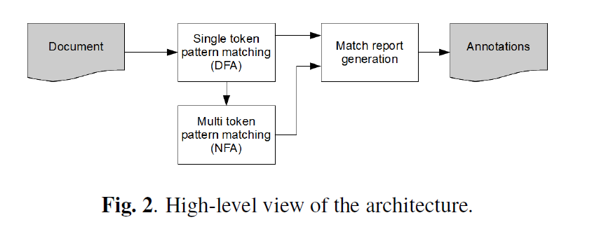
Architecture (2/12)
High-level view of the architecture

Slide 10
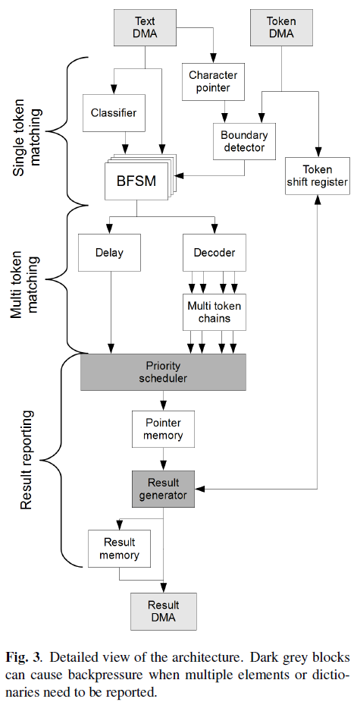
Architecture (3/12)
Overall hardware architecture
  2 individual DMA engines
    document text data
    token offset values
  The text data
    8-bit ASCII characters
  The token offsets
    a tuple of two 32-bit integer
    values representing the start
    and end offsets of a token.

Slide 11
Architecture (4/12)
Overall hardware architecture
  Counter
    as character pointer to keep track
    of the current position in the
    document text.
  Boundary detector
    determining the start and end
    characters of a token by
    comparing the character pointer
    with the incoming offset stream

Slide 12
Architecture (5/12)
Overall hardware architecture
  Boundary detector
    It controls the operation of the
    BFSMs by issuing start-of-token
    and end-of token pulses
  Decoder
    generate the appropriate transition
    signals for the multi-token chains
    implementing the NFA

Slide 13
Architecture (6/12)
BFSM
  A scalable Balanced Routing Table finite-state machine
  For regular expression matching with deterministic performance.
  AC-DFA based
  The default rules define the extra links that are necessary in an AC-DFA to return from failing patterns and only depend on the incoming character
  Transition rules depend on both the current state and the incoming character and define the positive transitions in the DFA

Slide 14
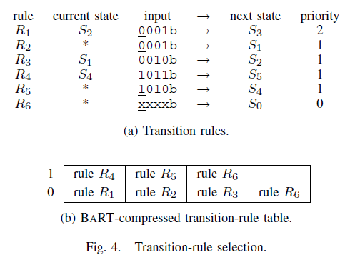
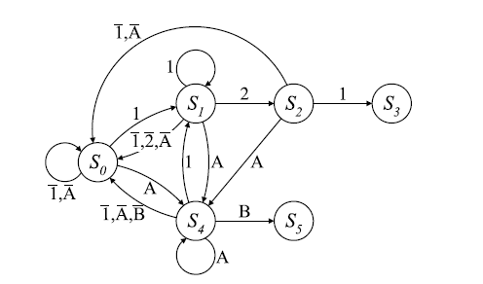

Architecture

Slide 15
Architecture (7/12)
BFSM
  Start from default state, if a token is detected by the Boundary Detector
    Compares the character pointer value to the start offset field for the current token.
  If these values match a start of token signal is activated
    Allowing the BFSM to leave its default state using the current character.
  The subsequent transitions are carried out without any external interaction
  When the end of a token is detected by the Boundary Detector
    An end of token signal is activated
  When the end of a token is signaled,
    The BFSM will be reset to its default state regardless of the calculated next state.

Slide 16
Architecture (8/12)
Multi-token NFA
  Custom hardware logic as described by Sidhu and Prasanna
  Each element has its own small machine consisting of registers connected by AND gates
  The number of registers is equal to the number of tokens in the multi-token element.
  A single token match id is decoded and fed to the individual register chains
    where it is combined with the previous matches.
  When a set of single token matches appears in the correct sequence, a multi-token match is signalled

Slide 17
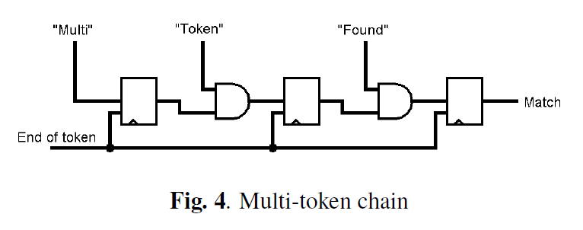
Architecture (9/12)
Multi-token NFA

Slide 18
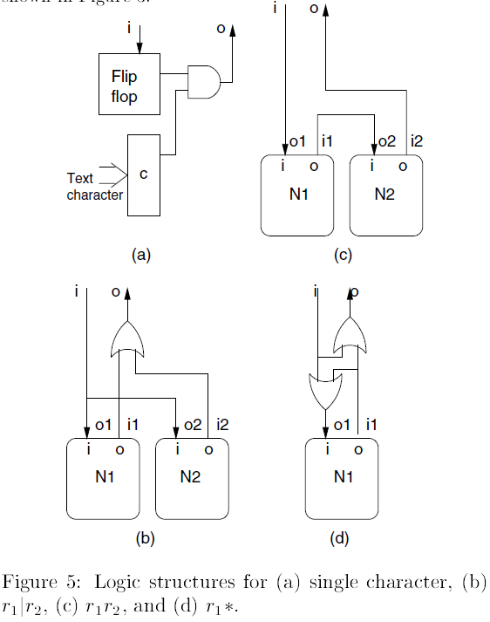
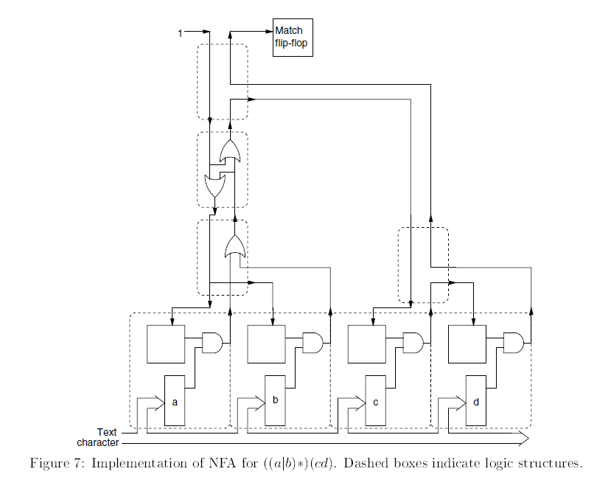
Architecture

Slide 19
Architecture (10/12)
Result reporting
  A single result is composed of a 32-bit dictionary identifier and the start and end offset position of the element found in the current document.
  A single element may be contained in multiple dictionaries
    The amount of data generated by the dictionary matcher may exceed the size of the actual document processed.
  Cascaded result lookup is used to efficiently store the information

Slide 20
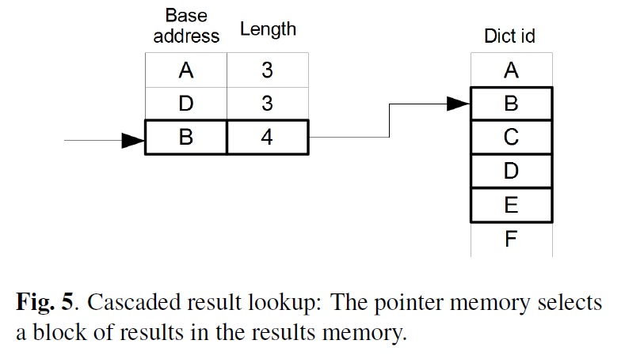
Architecture (11/12)
Result reporting

Slide 21
Architecture (12/12)
Compiler
  Takes the dictionaries as plain text files as input
  Each file is considered as one dictionary
  Each line in a file as a dictionary element
  Multi-token sequences
    Be defined in a dictionary file by separating the tokens by a whitespace character

Slide 22
Implementation
Altera Startix-IV GX530 FPGA
  250 MHz
  Latency can be neglected if a continuous stream of document data can be maintained at high frequency.
  Dual-port BlockRAM
  The number of pipeline stages is determined by
    the single token decoder
      grows with the number of single token patterns used in the multi-token patterns
    the multi-token result multiplexer
      the number of multi-token patterns

Slide 23
Evaluation (1/8)
Altera Quartus 12.1
The resource numbers were generated using a two threaded dual BFSM capable of processing two by two interleaved streams.
A set of test documents with sizes ranging from 100 B to 10 MB.

Slide 24
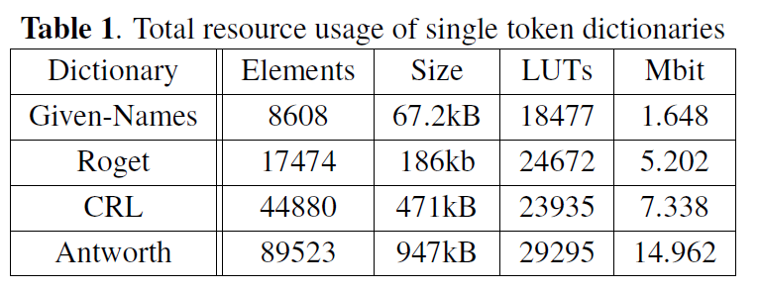
Evaluation (2/8)
Resource utilization
  Examine the impact of the size of the dictionary containing single token elements only
  The size of the transition rule memory

Slide 25
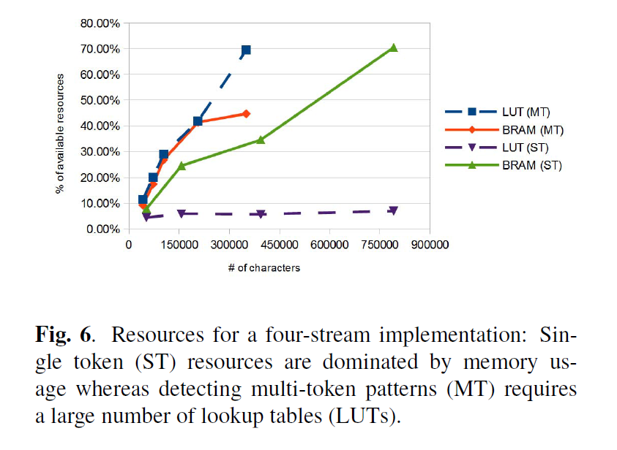
Evaluation (3/8)
Resource utilization

Slide 26

Evaluation (4/8)
Throughput
  $T=\frac{f}{2}∗n$
    T is the throughput in Bytes per second for ASCII characters
    f denotes the frequency
    n is the number of streams processed

Slide 27
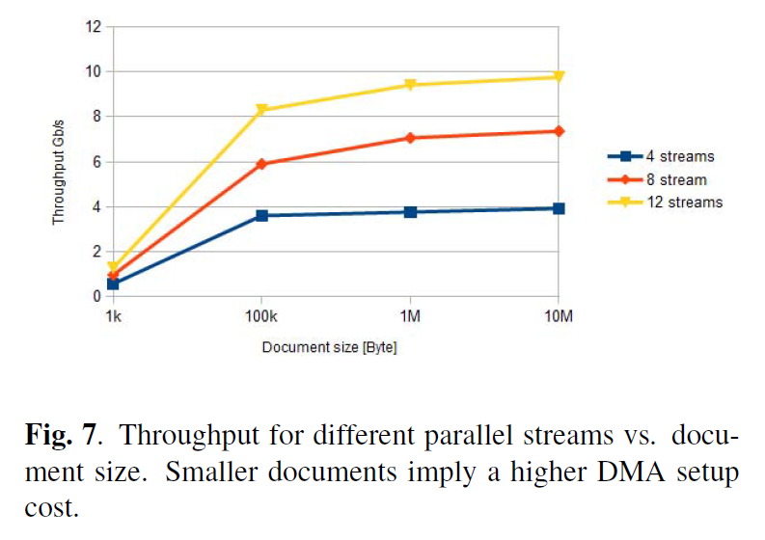
Evaluation (5/8)
Throughput

Slide 28
Evaluation (6/8)
Comparison with original software
  Intel® XEON® E5530 with 2.40 GHz using 16 threads
  Maximum throughput of 6.43 MB/s
  Compared with the 4 stream implementation
    14x to 75x improvement

Slide 29
Evaluation (7/8)
Comparison with related work
  The throughput
  The technology available at implementation time
  Storage efficiency
    logical cells per character (LC/char)
    memory bits per character (bit/char)

Slide 30
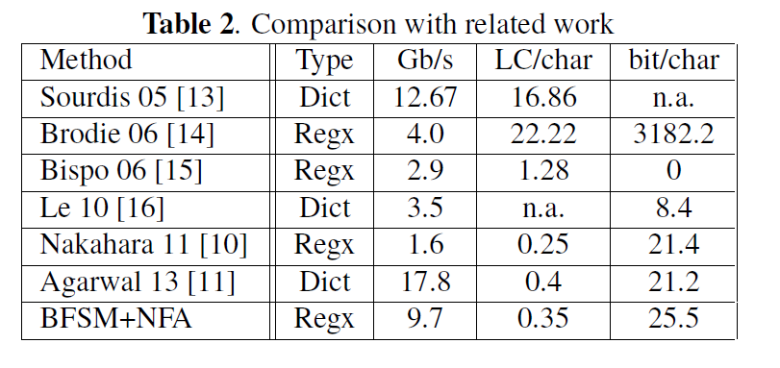
Evaluation (8/8)
Comparison with related work

